Slide 1
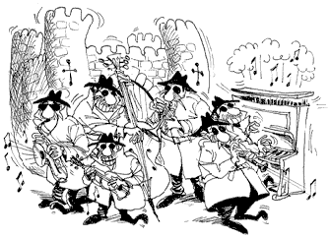
Prezentarea principalelor facilități oferite de pachetul Bouncy Castle Crypto pentru Java

Slide 2
Bouncy Castle (cryptography)
Bouncy Castle is a collection of APIs used in cryptography. It includes APIs for both the Java and the C# programming languages. The APIs are supported by a registered Australian charitable organization: Legion of the Bouncy Castle Inc.

Slide 3
History
The project was founded in May 2000. It was originally just Java. C# API added in 2004.
The original Java API consisted of approximately 27,000 lines of code, including test code and provided support for J2ME, a JCE/JCA provider, and basic X.509 certificate generation

Slide 4
Arhitectura
The Bouncy Castle architecture consists of two main components that support the base cryptographic capabilities. These are known as the 'light-weight' API, and the Java Cryptography Extension (JCE) provider. Further components built upon the JCE provider support additional functionality, such as PGP support, S/MIME, etc.

Slide 5
Some key properties of the project are:
Strong emphasis on standards compliance and adaptability.
Public support facilities include an issue tracker, dev mailing list and a wiki all available at the website.
Commercial support provided under resources for the relevant API listed on the Bouncy Castle website

Slide 6
Certificat de verificare
The first FIPS-certified releases were made available in November 2016, with the Java version being assigned certification number 2768 and the C# version being assigned certification number 2792.
FIPS (Federal Information Processing Standards) are U.S. government computer security standards that specify requirements for cryptography modules.

Slide 7
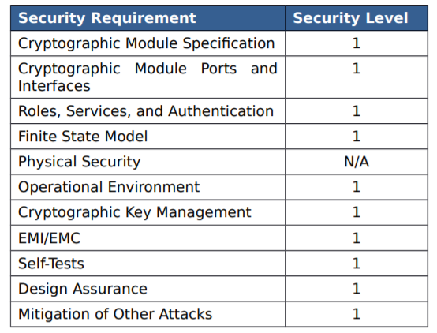
FIPS (Federal Information Processing Standards) 140-2
Nivele de securitate pentru modulele BC
Level 1 the lowest, imposes very limited requirements; loosely, all components must be "production-grade" and various egregious kinds of insecurity must be absent.
Level 2 adds requirements for physical tamper-evidence and role-based authentication.
Level 3 adds requirements for physical tamper-resistance (making it difficult for attackers to gain access to sensitive information contained in the module) and identity-based authentication, and for a physical or logical separation between the interfaces by which "critical security parameters" enter and leave the module, and its other interfaces.
Level 4 makes the physical security requirements more stringent, and requires robustness against environmental attacks.

Slide 8
Current feature list:
Generation and parsing of PKCS-12 files.
X.509: Generators and parsers for V1 and V3 certificates, V2 CRLs and attribute certificates.
PBE algorithms supported by PbeUtilities: PBEwithMD2andDES-CBC, PBEwithMD2andRC2-CBC, PBEwithMD5andDES-CBC, PBEwithMD5andRC2-CBC, PBEwithSHA1andDES-CBC, PBEwithSHA1andRC2-CBC, PBEwithSHA-1and128bitRC4, PBEwithSHA-1and40bitRC4, PBEwithSHA-1and3-keyDESEDE-CBC, PBEwithSHA-1and2-keyDESEDE-CBC, PBEwithSHA-1and128bitRC2-CBC, PBEwithSHA-1and40bitRC2-CBC, PBEwithHmacSHA-1, PBEwithHmacSHA-224, PBEwithHmacSHA-256, PBEwithHmacRIPEMD128, PBEwithHmacRIPEMD160, and PBEwithHmacRIPEMD256.
Signature algorithms supported by SignerUtilities: MD2withRSA, MD4withRSA, MD5withRSA, RIPEMD128withRSA, RIPEMD160withECDSA, RIPEMD160withRSA, RIPEMD256withRSA, SHA-1withRSA, SHA-224withRSA, SHA-256withRSAandMGF1, SHA-384withRSAandMGF1, SHA-512withRSAandMGF1, SHA-1withDSA, and SHA-1withECDSA.
Symmetric key algorithms: AES, Blowfish, Camellia, CAST5, CAST6, ChaCha, DES, DESede, GOST28147, HC-128, HC-256, IDEA, ISAAC, Noekeon, RC2, RC4, RC5-32, RC5-64, RC6, Rijndael, Salsa20, SEED, Serpent, Skipjack, TEA/XTEA, Threefish, Tnepres, Twofish, VMPC and XSalsa20.
Symmetric key modes: CBC, CFB, CTS, GOFB, OFB, OpenPGPCFB, and SIC (or CTR).
Symmetric key paddings: ISO10126d2, ISO7816d4, PKCS-5/7, TBC, X.923, and Zero Byte.
Asymmetric key algorithms: ElGamal, DSA, ECDSA, NaccacheStern and RSA (with blinding).
Asymmetric key paddings/encodings: ISO9796d1, OAEP, and PKCS-1.
AEAD block cipher modes: CCM, EAX, GCM and OCB.
Digests: GOST3411, Keccak, MD2, MD4, MD5, RIPEMD128, RIPEMD160, RIPEMD256, RIPEMD320, SHA-1, SHA-224, SHA-256, SHA-384, SHA-512, SHA3, Tiger, and Whirlpool.
XOFs: SHAKE.
Signer mechanisms: DSA, ECDSA, ECGOST3410, ECNR, GOST3410, ISO9796d2, PSS, RSA, X9.31-1998.
Key Agreement: Diffie-Hellman, EC-DH, EC-MQV, J-PAKE, SRP-6a.
Macs: CBCBlockCipher, CFBBlockCipher, CMAC, GMAC, GOST28147, HMac, ISO9797 Alg. 3, Poly1305, SipHash, SkeinMac, VMPCMAC.
PBE generators: PKCS-12, and PKCS-5 - schemes 1 and 2.
OpenPGP (RFC 4880)
Cryptographic Message Syntax (CMS, RFC 3852), including streaming API.
Online Certificate Status Protocol (OCSP, RFC 2560).
Time Stamp Protocol (TSP, RFC 3161).
TLS/DTLS client/server up to version 1.2, with support for the most common ciphersuites and extensions, and many less common ones. Non-blocking API available.
Elliptic Curve Cryptography: support for generic F2m and Fp curves, high-performance custom implementations for many standardized curves.
Reading/writing of PEM files, including RSA and DSA keys, with a variety of encryptions.
PKIX certificate path validation

